Slide 1
VIEW-hub Report: Global Vaccine Introduction and Implementation
IVAC VIEW-hub Global Vaccine Introduction and Implementation Report
March 2016
Johns Hopkins Bloomberg School of Public Health
International Vaccine Access Center (IVAC)
Developed from information in the VIEW-hub database/platform
For other VIEW-hub-related inquiries, please contact Linh Nguyen at linh.nguyen@jhu.edu

Slide 2
Historical Vaccine Introduction by Income Group
Note: Limited projections are available for PCV introduction in High-Income Countries
Source: International Vaccine Access Center (IVAC), Johns Hopkins Bloomberg School of Public Health. VIEW-hub Global Vaccine Introduction and Implementation Report, March 2016.

Slide 3
Historical Hib Vaccine Introduction by Income Group
Source: International Vaccine Access Center (IVAC), Johns Hopkins Bloomberg School of Public Health. VIEW-hub Global Vaccine Introduction and Implementation Report, March 2016.

Slide 4
Historical PCV Introduction by Income Group
Note: Limited projections are available for PCV introduction in High-, Upper-, and Lower-Middle Income Countries
Source: International Vaccine Access Center (IVAC), Johns Hopkins Bloomberg School of Public Health. VIEW-hub Global Vaccine Introduction and Implementation Report, March 2016.

Slide 5
Historical Rotavirus Vaccine Introduction by Income Group
Note: Limited projections are available for RV introduction in High-, Upper-, and Lower-Middle Income Countries
Source: International Vaccine Access Center (IVAC), Johns Hopkins Bloomberg School of Public Health. VIEW-hub Global Vaccine Introduction and Implementation Report, March 2016.

Slide 6
Historical IPV Introduction by Income Group
Note: Limited projections are available for IPV introduction in High-, Upper-, and Lower-Middle Income Countries
Source: International Vaccine Access Center (IVAC), Johns Hopkins Bloomberg School of Public Health. VIEW-hub Global Vaccine Introduction and Implementation Report, March 2016.

Slide 7
Global Hib Vaccine Introduction Status by Year
Target: 194 countries
Source: International Vaccine Access Center (IVAC), Johns Hopkins Bloomberg School of Public Health. VIEW-hub Global Vaccine Introduction and Implementation Report, December2015.

Slide 8
Global Hib Vaccine Introduction Status
Source: International Vaccine Access Center (IVAC), Johns Hopkins Bloomberg School of Public Health. VIEW-hub Global Vaccine Introduction and Implementation Report, March 2016.

Slide 9
Global Introduction Status of Hib Vaccine
 | Introduced – National (191)
 | Introduced – Subnational (1)
Source: International Vaccine Access Center (IVAC), Johns Hopkins Bloomberg School of Public Health. VIEW-hub Global Vaccine Introduction and Implementation Report, March 2016.
Notes:
REGIONAL/PHASED INTRODUCTIONS:
-Belarus

Slide 10
Hib Vaccine – Current Product
 | Hib (Mono) (10)
 | DTP-HepB-Hib (Penta) (118)
 | Other combination vaccine (32)
 | Multiple formulations (32)
Gavi countries
Source: International Vaccine Access Center (IVAC), Johns Hopkins Bloomberg School of Public Health. VIEW-hub Global Vaccine Introduction and Implementation Report, March 2016.

Slide 11
Hib Vaccine – Current Dosing Schedule
 | 2+1 (14)
 | 3+0 (110)
 | 3+1 (65)
 | 3+0 and 3+1 (3)
Gavi countries
Source: International Vaccine Access Center (IVAC), Johns Hopkins Bloomberg School of Public Health. VIEW-hub Global Vaccine Introduction and Implementation Report, March 2016.

Slide 12
Global Coverage and Access to Hib Vaccine
Source: International Vaccine Access Center (IVAC), Johns Hopkins Bloomberg School of Public Health. VIEW-hub Global Vaccine Introduction and Implementation Report, March 2016.
Notes:
Coverage = # of surviving infants covered by DTP3 vaccine in countries that have introduced Hib vaccine
Access = # of surviving infants that live in countries that have introduced Hib vaccine

Slide 13
Gavi Hib Vaccine Introduction Status by Year
100% Gavi countries reached
Source: International Vaccine Access Center (IVAC), Johns Hopkins Bloomberg School of Public Health. VIEW-hub Global Vaccine Introduction and Implementation Report, March 2016.

Slide 14
Gavi Hib Vaccine Introduction Status
Source: International Vaccine Access Center (IVAC), Johns Hopkins Bloomberg School of Public Health. VIEW-hub Global Vaccine Introduction and Implementation Report, March 2016.

Slide 15
Gavi Countries’ Introduction Status of Hib Vaccine
 | Introduced – National (73)
Source: International Vaccine Access Center (IVAC), Johns Hopkins Bloomberg School of Public Health. VIEW-hub Global Vaccine Introduction and Implementation Report, March 2016.

Slide 16
Coverage and Access to Hib Vaccine in Gavi Countries
Source: International Vaccine Access Center (IVAC), Johns Hopkins Bloomberg School of Public Health. VIEW-hub Global Vaccine Introduction and Implementation Report, March 2016.
Notes:
Coverage = # of surviving infants covered by DTP3 vaccine in Gavi countries that have introduced Hib vaccine
Access = # of surviving infants that live in Gavi countries that have introduced Hib vaccine

Slide 17
Global PCV Introduction Status by Year
Target: 194 countries
Source: International Vaccine Access Center (IVAC), Johns Hopkins Bloomberg School of Public Health. VIEW-hub Global Vaccine Introduction and Implementation Report, March 2016.

Slide 18
Global PCV Introduction Status
Source: International Vaccine Access Center (IVAC), Johns Hopkins Bloomberg School of Public Health. VIEW-hub Global Vaccine Introduction and Implementation Report, March 2016.

Slide 19
Global Introduction Status of PCV
 | Introduced – National (128)
 | Introduced – Subnational (3)
 | Introduced – Risk Program (6)
Source: International Vaccine Access Center (IVAC), Johns Hopkins Bloomberg School of Public Health. VIEW-hub Global Vaccine Introduction and Implementation Report, March 2016.

Slide 20
PCV – Current Product
 | PCV10 (30)
 | PCV13 (94)
 | PCV10 and PCV13 (11)
Gavi countries
Source: International Vaccine Access Center (IVAC), Johns Hopkins Bloomberg School of Public Health. VIEW-hub Global Vaccine Introduction and Implementation Report, March 2016.
Notes:
Belarus and Mauritius’s PCV product unknown.

Slide 21
PCV – Current Dosing Schedule
 | 2+1 (50)
 | 3+0 (58)
 | 3+1 (25)
 | 2+1 and 3+1 (1)
Gavi countries
Source: International Vaccine Access Center (IVAC), Johns Hopkins Bloomberg School of Public Health. VIEW-hub Global Vaccine Introduction and Implementation Report, March 2016.
Notes:
Kyrgyzstan, Lesotho, and Mauritius’s PCV dosing schedule unknown.

Slide 22
PCV– Impact Studies
 | Has ≥1 ongoing/published impact study (58)
Source: International Vaccine Access Center (IVAC), Johns Hopkins Bloomberg School of Public Health. VIEW-hub Global Vaccine Introduction and Implementation Report, March 2016.
Notes:
These include countries that are using and evaluating rotavirus vaccine, and countries that have yet to introduce but are modeling/projecting economic impact.
4/58 countries shown here are countries that have not yet introduced rotavirus vaccine, but are conducting modeled economic impact studies.
These 4 countries are:
China
Croatia
Malaysia
Somalia

Slide 23
Global Coverage and Access to PCV
Source: International Vaccine Access Center (IVAC), Johns Hopkins Bloomberg School of Public Health. VIEW-hub Global Vaccine Introduction and Implementation Report, March 2016.
Notes:
Coverage = # of surviving infants covered by DTP3 vaccine in countries that have introduced PCV
Access = # of surviving infants that live in countries that have introduced PCV

Slide 24
Gavi PCV Introduction Status by Year
Target: 73 countries
Source: International Vaccine Access Center (IVAC), Johns Hopkins Bloomberg School of Public Health. VIEW-hub Global Vaccine Introduction and Implementation Report, March 2016.

Slide 25
Gavi PCV Introduction Status
Source: International Vaccine Access Center (IVAC), Johns Hopkins Bloomberg School of Public Health. VIEW-hub Global Vaccine Introduction and Implementation Report, March 2016.

Slide 26
Gavi Countries’ Introduction Status of PCV
 | Introduced – National (54)
 | Introduced – Subnational (1)
 | Not Introduced (18)
Source: International Vaccine Access Center (IVAC), Johns Hopkins Bloomberg School of Public Health. VIEW-hub Global Vaccine Introduction and Implementation Report, March 2016.
Notes:
Introduced – Phased: Nigeria

Slide 27
Coverage and Access to PCV in Gavi Countries
Source: International Vaccine Access Center (IVAC), Johns Hopkins Bloomberg School of Public Health. VIEW-hub Global Vaccine Introduction and Implementation Report, March 2016.
Notes:
Coverage = # of surviving infants covered by DTP3 vaccine in Gavi countries that have introduced PCV
Access = # of surviving infants that live in Gavi countries that have introduced PCV

Slide 28
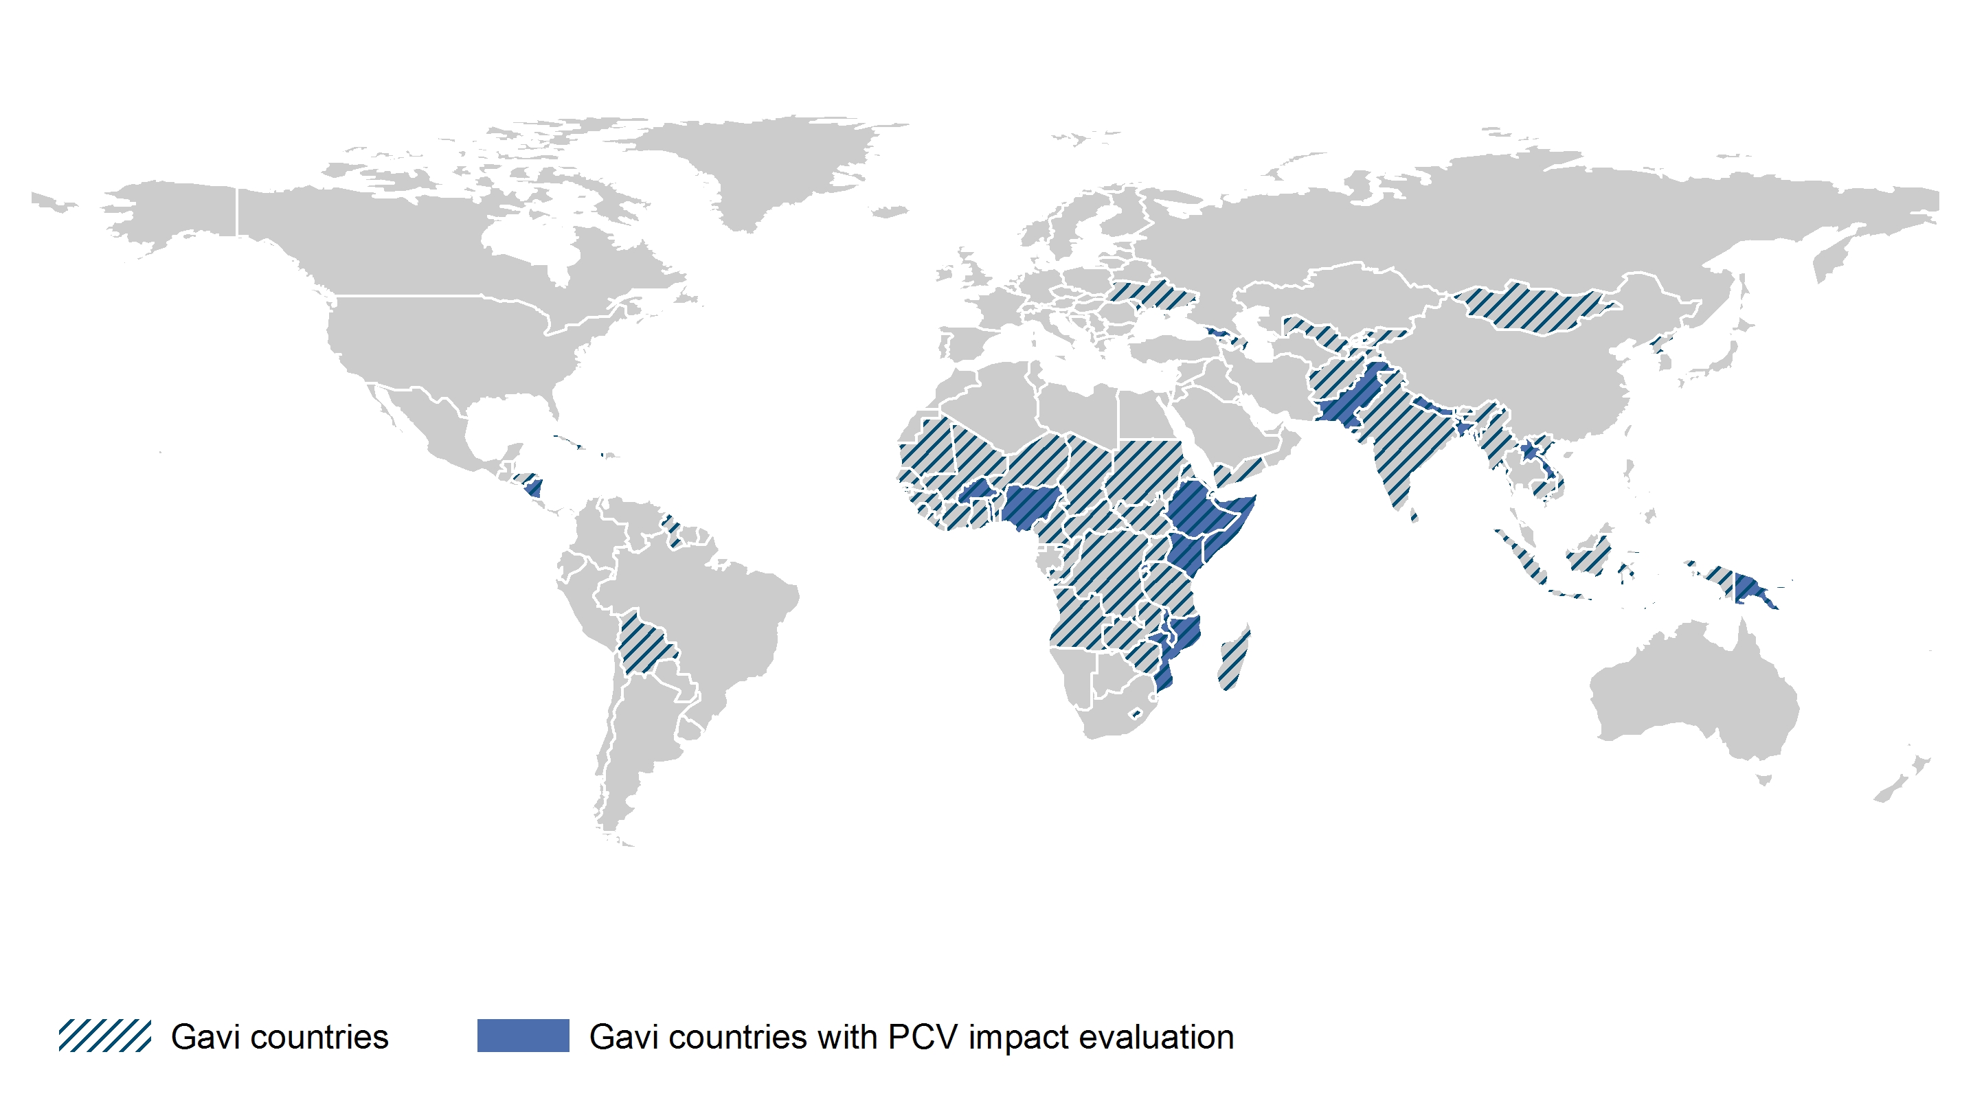
PCV – Impact Studies
A Closer Look at Gavi Countries
Gavi countries (73)
 | Has ≥1 ongoing/published impact study (17)
Source: International Vaccine Access Center (IVAC), Johns Hopkins Bloomberg School of Public Health. VIEW-hub Global Vaccine Introduction and Implementation Report, March 2016.
Notes:
These include Gavi countries that are using and evaluating rotavirus vaccine, and countries that have yet to introduce but are modeling/projecting economic impact.
1/17 countries (Somalia) shown here has not yet introduced rotavirus vaccine, but is conducting modeled economic impact studies.

Slide 29
Global Rotavirus Vaccine Introduction Status by Year
Target: 194 countries
Source: International Vaccine Access Center (IVAC), Johns Hopkins Bloomberg School of Public Health. VIEW-hub Global Vaccine Introduction and Implementation Report, March 2016.

Slide 30
Global Rotavirus Vaccine Introduction Status
Source: International Vaccine Access Center (IVAC), Johns Hopkins Bloomberg School of Public Health. VIEW-hub Global Vaccine Introduction and Implementation Report, March 2016.

Slide 31
Global Introduction Status of Rotavirus Vaccine
 | Introduced – National (80)
 | Introduced – Subnational (7)
Source: International Vaccine Access Center (IVAC), Johns Hopkins Bloomberg School of Public Health. VIEW-hub Global Vaccine Introduction and Implementation Report, March 2016.
Notes:
Subnational Intros: Canada, India, Italy, Mali, Philippines, Sweden, Thailand

Slide 32
Rotavirus Vaccine – Current Product
*
 | RV1 (61)
 | RV5 (17)
 | RV1 and RV5 (8)
Gavi countries
*
India is using a domestically manufactured RV1 (Rotavac, Bharat Vaccines).
Source: International Vaccine Access Center (IVAC), Johns Hopkins Bloomberg School of Public Health. VIEW-hub Global Vaccine Introduction and Implementation Report, March 2016.
Notes:
Mauritius’s rotavirus vaccine product unknown.
India is using Rotavac, a monovalent rotavirus vaccine. The rest of the RV1-using countries are using Rotarix (by GSK).

Slide 33
Rotavirus Vaccine – Current Dosing Schedule
 | 2+0 (59)
 | 3+0 (18)
 | 2+0 and 3+0 (8)
Gavi countries
Source: International Vaccine Access Center (IVAC), Johns Hopkins Bloomberg School of Public Health. VIEW-hub Global Vaccine Introduction and Implementation Report, March 2016.
Notes:
Mauritius’s rota dosing schedule unknown.

Slide 34
Rotavirus Vaccine – Impact Studies
 | Has ≥1 ongoing/published impact study (47)
Source: International Vaccine Access Center (IVAC), Johns Hopkins Bloomberg School of Public Health. VIEW-hub Global Vaccine Introduction and Implementation Report, March 2016.
Notes:
These include countries that are using and evaluating rotavirus vaccine, and countries that have yet to introduce but are modeling/projecting economic impact.
10/47 countries shown here are countries that have not yet introduced rotavirus vaccine, but are conducting modeled economic impact studies.
These 10 countries are:
Albania
France
Indonesia
Iran
Ireland
Kyrgyzstan
Netherlands
Somalia
Turkey
Viet Nam

Slide 35
Global Coverage and Access to Rotavirus Vaccine
Source: International Vaccine Access Center (IVAC), Johns Hopkins Bloomberg School of Public Health. VIEW-hub Global Vaccine Introduction and Implementation Report, March 2016.
Notes:
Coverage = # of surviving infants covered by DTP3 vaccine in countries that have introduced Rota vaccine
Access = # of surviving infants that live in countries that have introduced Rota vaccine

Slide 36
Gavi Rotavirus Vaccine Introduction Status by Year
Target: 73 countries
Source: International Vaccine Access Center (IVAC), Johns Hopkins Bloomberg School of Public Health. VIEW-hub Global Vaccine Introduction and Implementation Report, March 2016.

Slide 37
Gavi Rotavirus Vaccine Introduction Status
Source: International Vaccine Access Center (IVAC), Johns Hopkins Bloomberg School of Public Health. VIEW-hub Global Vaccine Introduction and Implementation Report, March 2016.

Slide 38
Gavi Countries’ Introduction Status of Rotavirus Vaccine
 | Introduced – National (37)
 | Introduced – Subnational (2)
 | Not Introduced (34)
Source: International Vaccine Access Center (IVAC), Johns Hopkins Bloomberg School of Public Health. VIEW-hub Global Vaccine Introduction and Implementation Report, March 2016.
Notes:
Subnational:
-Mali
-India

Slide 39
Coverage and Access to Rotavirus Vaccine in Gavi Countries
Source: International Vaccine Access Center (IVAC), Johns Hopkins Bloomberg School of Public Health. VIEW-hub Global Vaccine Introduction and Implementation Report, March 2016.

Slide 40
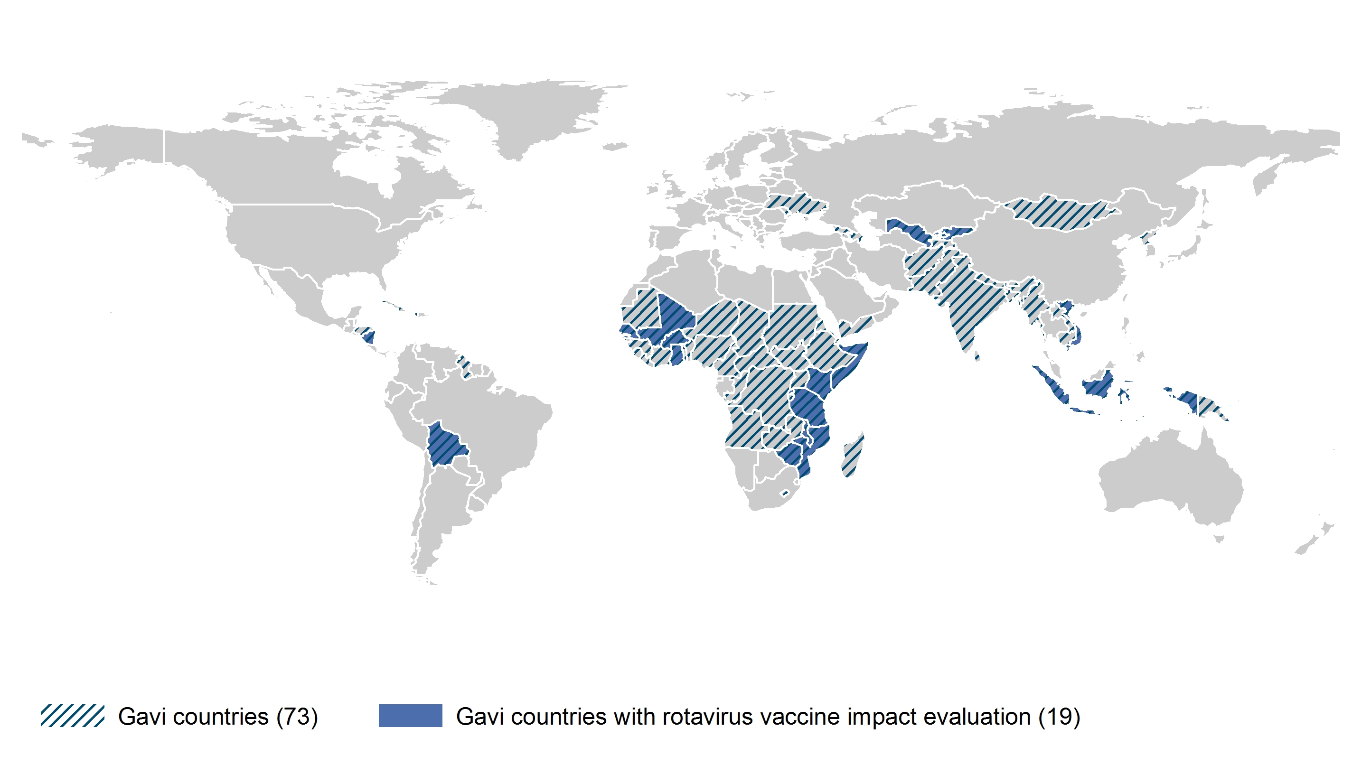
Rotavirus Vaccine – Impact Studies
A Closer Look at Gavi Countries
Gavi countries (73)
 | Has ≥1 ongoing/published impact study (19)
Source: International Vaccine Access Center (IVAC), Johns Hopkins Bloomberg School of Public Health. VIEW-hub Global Vaccine Introduction and Implementation Report, March 2016.
Notes:
These include countries that are using and evaluating rotavirus vaccine, and countries that have yet to introduce but are modeling/projecting economic impact.
4/19 countries shown here are countries that have not yet introduced rotavirus vaccine, but are conducting modeled economic impact studies.
These 4 countries are:
Indonesia
Kyrgyzstan
Somalia
Viet Nam

Slide 41
Global IPV Introduction Status by Year
Target: 194 countries
Source: International Vaccine Access Center (IVAC), Johns Hopkins Bloomberg School of Public Health. VIEW-hub Global Vaccine Introduction and Implementation Report, March 2016.

Slide 42
Global IPV Introduction Status
Source: International Vaccine Access Center (IVAC), Johns Hopkins Bloomberg School of Public Health. VIEW-hub Global Vaccine Introduction and Implementation Report, March 2016.

Slide 43
Global Introduction Status of IPV
 | Introduced – National (157)
 | Introduced – Subnational (6)
Countries using IPV without OPV (49)
Note: All other IPV-using countries are also using OPV in their national schedule.
Source: International Vaccine Access Center (IVAC), Johns Hopkins Bloomberg School of Public Health. VIEW-hub Global Vaccine Introduction and Implementation Report, September 2015.
Notes:
Subnational intros: China, Congo, Haiti, India, Philippines, Somalia

Slide 44
IPV – Current Product
 | IPV (Stand alone) (69)
 | Combination vaccine (54)
 | Multiple formulations (14)
 | Product unknown (26)
Gavi countries
Source: International Vaccine Access Center (IVAC), Johns Hopkins Bloomberg School of Public Health. VIEW-hub Global Vaccine Introduction and Implementation Report, March 2016.
Notes:
IPV product unknown for 26 countries:
ANTIGUA AND BARBUDA; BOTSWANA; CHINA; COLOMBIA; COOK ISLANDS; DOMINICA; GRENADA; GUATEMALA; NAMIBIA; NAURU; NICARAGUA; PARAGUAY; SAINT KITTS AND NEVI;S SAINT LUCIA; SAMOA; SENEGAL; SEYCHELLES; SINGAPORE; SURINAME; THAILAND; TONGA; TRINIDAD AND TOBAGO; TUNISIA; TUVALU; VANUATU; VENEZUELA

Slide 45
IPV– Current Dosing Schedule
 | 1+0 (73)
 | 2+0 (15)
 | 2+1 (11)
 | 3+0 and/or 3+1 (53)
 | Dosing Schedule Unknown (11)
Gavi countries
Source: International Vaccine Access Center (IVAC), Johns Hopkins Bloomberg School of Public Health. VIEW-hub Global Vaccine Introduction and Implementation Report, March 2016.
Notes:
Dosing schedule unknown for 11 countries: Algeria, Andorra, Antigua and Barbuda, Cote D’Ivoire, DPR Korea, Gambia, Libya, Macedonia, Nauru, Saint Kitts and Nevis, and Tonga.

Slide 46
Global Coverage and Access to IPV
Source: International Vaccine Access Center (IVAC), Johns Hopkins Bloomberg School of Public Health. VIEW-hub Global Vaccine Introduction and Implementation Report, March 2016.
Notes:
Coverage = # of surviving infants covered by DTP3 vaccine in countries that have introduced Rota vaccine
Access = # of surviving infants that live in countries that have introduced Rota vaccine

Slide 47
Gavi IPV Introduction Status by Year
Target: 73 countries
Source: International Vaccine Access Center (IVAC), Johns Hopkins Bloomberg School of Public Health. VIEW-hub Global Vaccine Introduction and Implementation Report, March 2016.

Slide 48
Gavi IPV Introduction Status
Source: International Vaccine Access Center (IVAC), Johns Hopkins Bloomberg School of Public Health. VIEW-hub Global Vaccine Introduction and Implementation Report, March 2016.

Slide 49
Gavi Countries’ Introduction Status of IPV
 | Introduced – National (44)
 | Introduced – Subnational (4)
 | Not Introduced (25)
Source: International Vaccine Access Center (IVAC), Johns Hopkins Bloomberg School of Public Health. VIEW-hub Global Vaccine Introduction and Implementation Report, March 2016.
Notes:
Subnational intros: Congo, Haiti, India, Somalia

Slide 50
Coverage and Access to IPV in Gavi Countries
Source: International Vaccine Access Center (IVAC), Johns Hopkins Bloomberg School of Public Health. VIEW-hub Global Vaccine Introduction and Implementation Report, March 2016.

Slide 51
Acknowledgements and Notes
This report is developed by the International Vaccine Access Center (IVAC) at the Johns Hopkins Bloomberg School of Public Health, with support from Gavi, the Bill & Melinda Gates Foundation, and The Task Force for Global Health.
Please note that all forecasted introductions in this report rest on assumptions and may vary. Planned vaccine introduction dates do not imply an obligation by Gavi to support coverage.
Definitions and sources are available in VIEW-hub at www.VIEW-hub.org.
The most current VIEW-hub Report and matching slides can be found at: http://www.jhsph.edu/research/centers-and-institutes/ivac/view-hub/index.html.
For any VIEW-hub-related inquiries, please email Linh Nguyen at linh.nguyen@jhu.edu.

